Slide 1
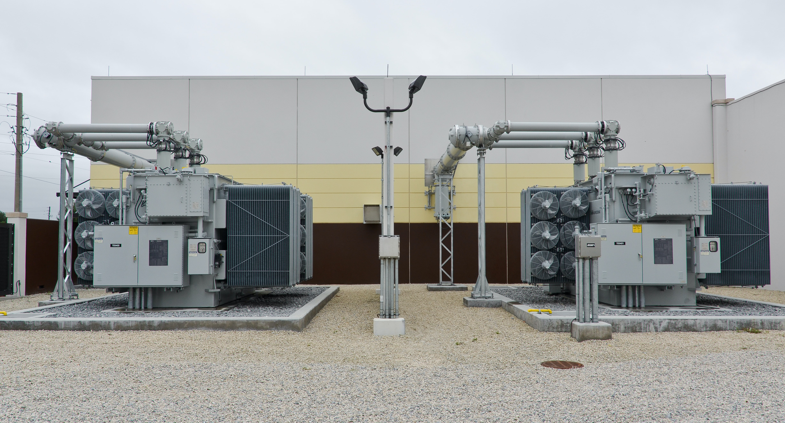

Spire: Cyberattack-resilient Power Grid Substations
Dr. Yair Amir
Department of Computer Science
Johns Hopkins University
yairamir@jhu.edu
Picture by
Notes:
American public power association - https://www.publicpower.org/

Slide 2
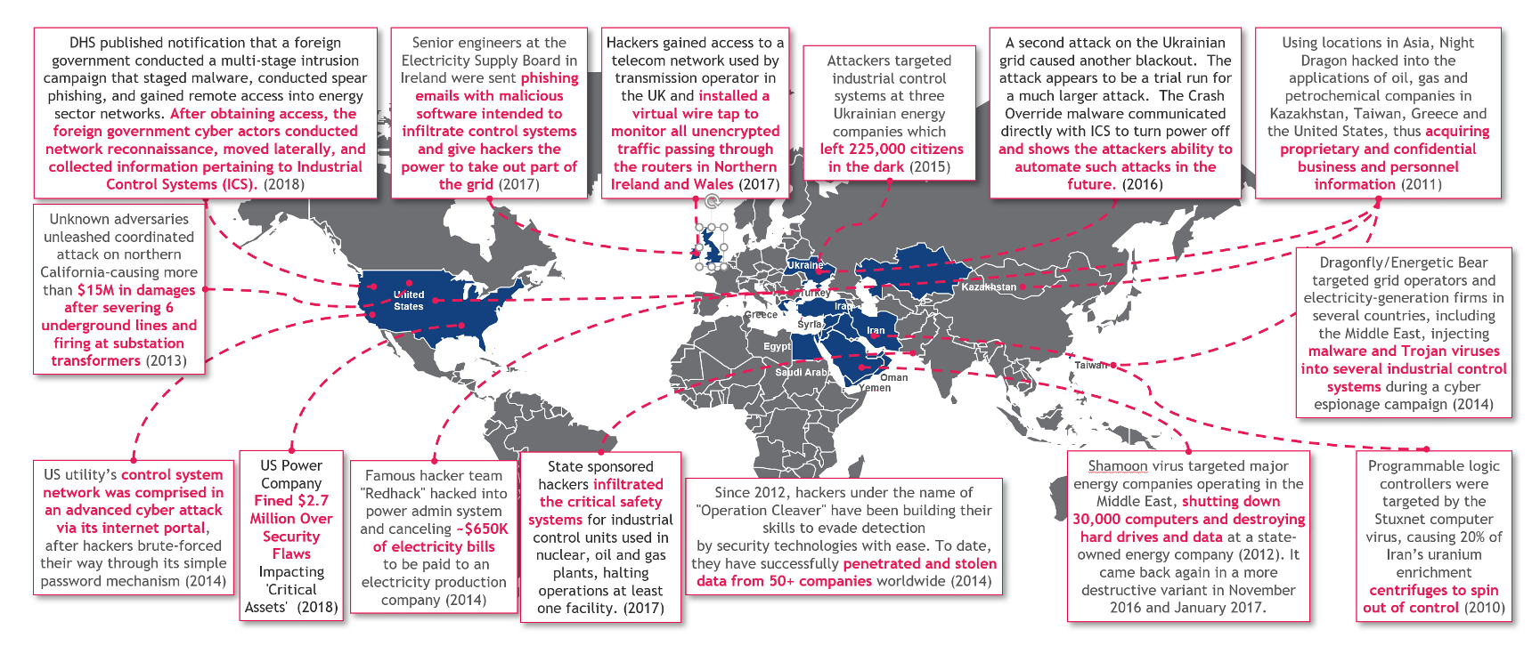
Increasing Cyber Attacks on Grid Control Systems Reinforce the Need for Intrusion-tolerant Systems…
Source: https://www.weforum.org/agenda/2019/03/hackers-are-causing-blackouts-it-s-time-to-boost-our-cyber-resilience/
Notes:
World economic forum

Slide 3
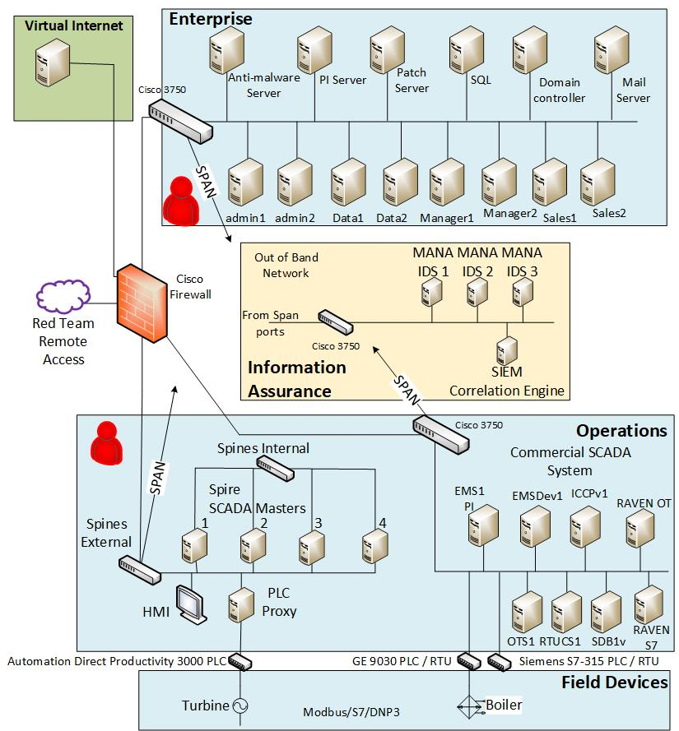
DoD Red Team Experiment (March – April 2017)
Hosted at Pacific Northwest National Lab
Sandia National Labs red team attacked NIST-compliant commercial SCADA architecture and Spire
Commercial system completely taken over
MITM from enterprise network, direct PLC access within hours
Spire completely unaffected
Even after providing access to replica + source code

Slide 4
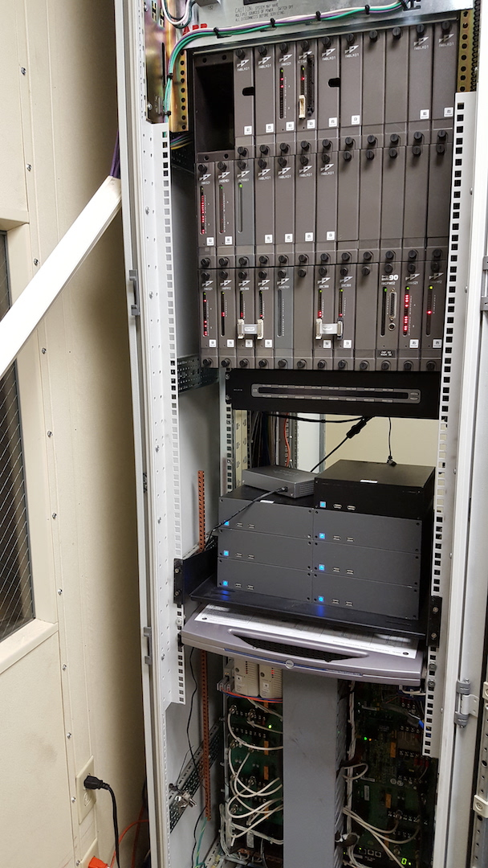
Hawaiian Electric Test Deployment (January – February 2018)
Spire test deployment at Hawaiian Electric
“Mothballed” Honolulu plant
Managed small power topology, controlling 3 physical breakers via a Modbus PLC
Outcome
Operated continuously in a real environment for 6 days without interfering with plant systems
Successfully met performance (latency) requirements
Babay, Amy, John Schultz, Thomas Tantillo, Samuel Beckley, Eamon Jordan, Kevin Ruddell, Kevin Jordan, and Yair Amir. "Deploying intrusion-tolerant SCADA for the power grid." In 2019 49th Annual IEEE/IFIP International Conference on Dependable Systems and Networks (DSN), pp. 328-335, 2019.

Slide 5
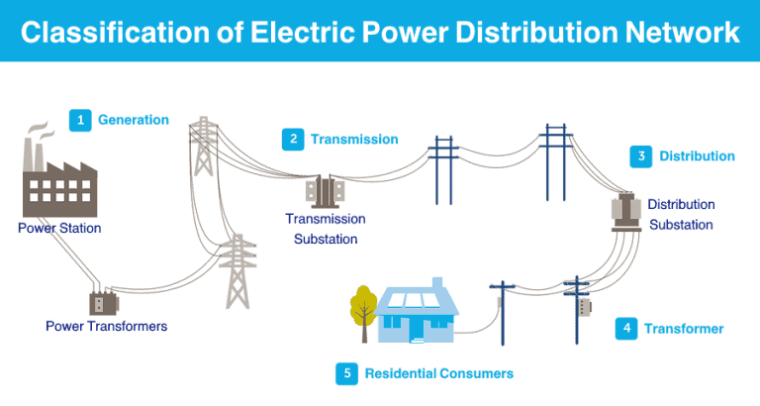
Byzantine-resilient High-Voltage Relays in the Substation (2020 — 2023)
Department of Energy identified high-voltage transformers as the most vulnerable component of the grid
Cost millions of dollars
Long procurement process
Compromising a few can impact the grid
High Voltage Protective Relays protect the transformers; Protective Relays may be vulnerable to cyberattacks
Byzantine-resilience: resilient all the way to intrusion-tolerance -- working correctly even after a successful intrusion by a sophisticated adversary
Source: https://www.electricaltechnology.org/2021/10/electric-power-distribution-network.html

Slide 6
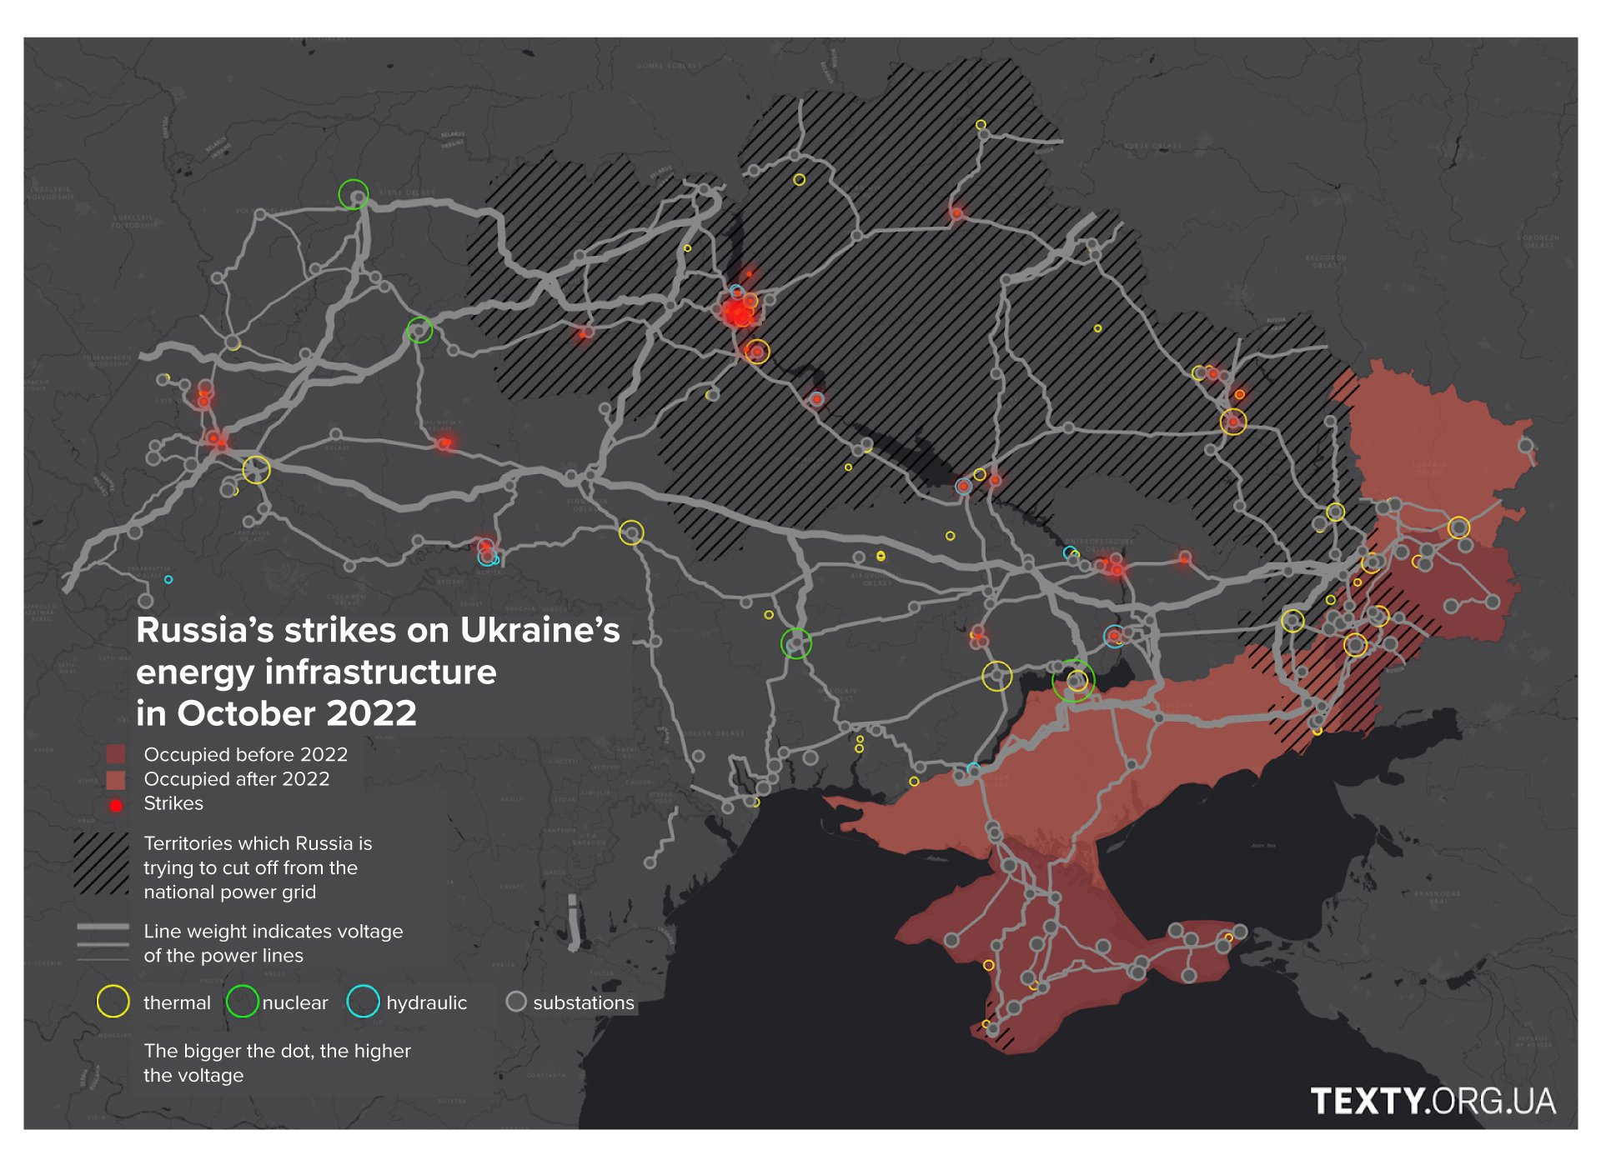
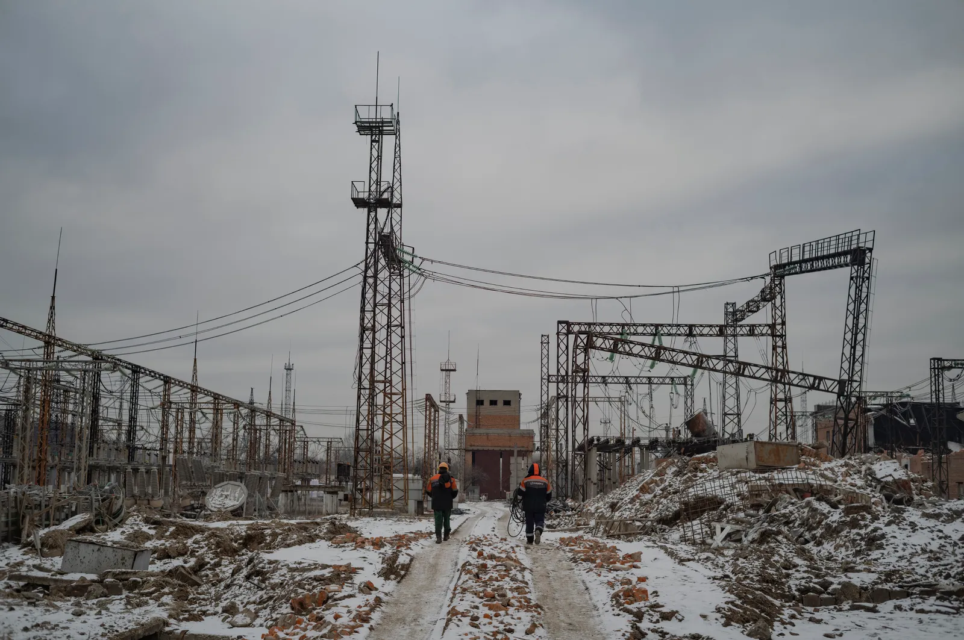
Physical Attacks on Substations in Ukraine
Ukrenergo workers at a substation in eastern Ukraine are salvaging pieces of equipment that still can be used for repairs.
source: https://www.newyorker.com/culture/photo-booth/the-impact-of-russian-missile-strikes-on-ukraines-power-grid
“Russia is systematically shelling electrical substations throughout Ukraine.”
source: https://texty.org.ua/articles/108414/whats-up-with-the-power-how-russia-destroys-energy-infrastructure/

Slide 7
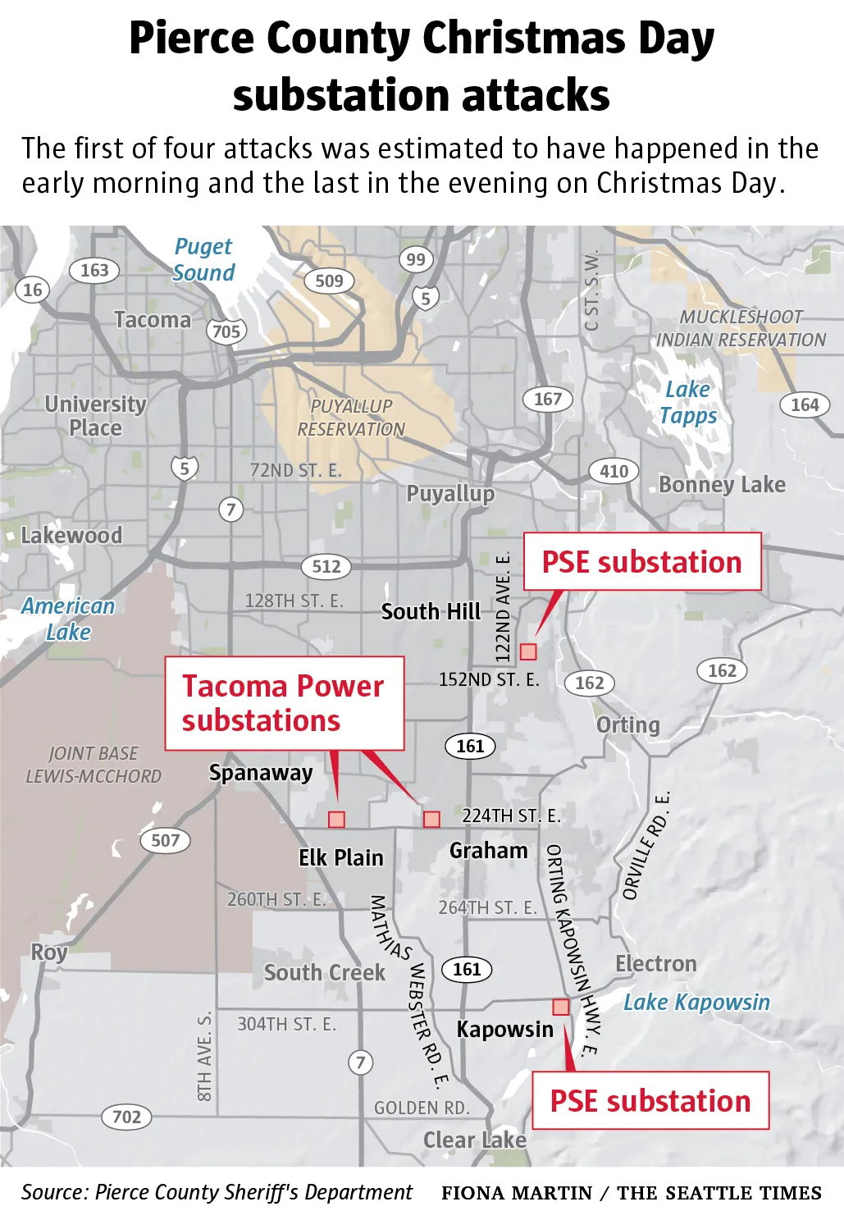
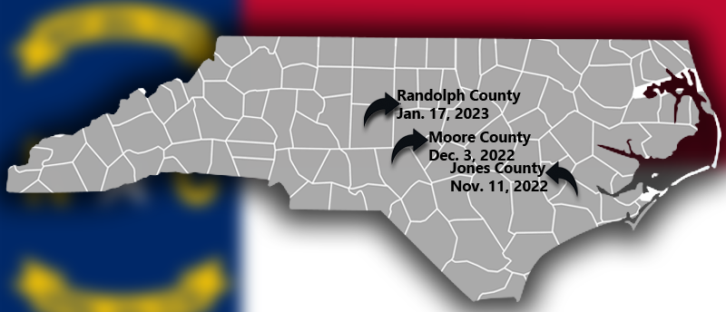
Physical Attacks on Substations in the US
“Attacks on Electrical Substations Raise Alarm.”
Sources:
https://www.nytimes.com/2023/02/04/us/electrical-substation-attacks-nc-wa.html
https://www.seattletimes.com/seattle-news/what-motivated-the-pacific-northwest-substation-attacks/
https://myfox8.com/news/investigations/power-grid-attack/2-months-since-moore-county/

Slide 8
Byzantine-resilient High-Voltage Relays in the Substation (2020 — 2023)
The Cyberattack angle
A protective relay that does not trip when it should, can cause irreparable damage to the transformer and its connected customers
A protective relay that does unnecessarily trip, causes a major disruption to a large number of customers
DoE project addressing that angle
Collaboration between Pacific Northwest National Laboratory (PNNL), Sandia National Laboratories (SNL), and Johns Hopkins
Industry partners: GE, Siemens, and Hitachi Energy
Source: https://www.electricaltechnology.org/2021/10/electric-power-distribution-network.html

Slide 9
Designing Byzantine-resilient Protection
Real-Time
Very exact real-time latency requirement of quarter-power cycle in all operating conditions
Economic Factors
The protective relay is a reasonably expensive device and there are many of them in the system
Long System Lifetime
Resiliency with long system lifetime with continuous availability
Seamless System Integration
The solution should be capable of integrating into existing substations without changes to the infrastructure

Slide 10
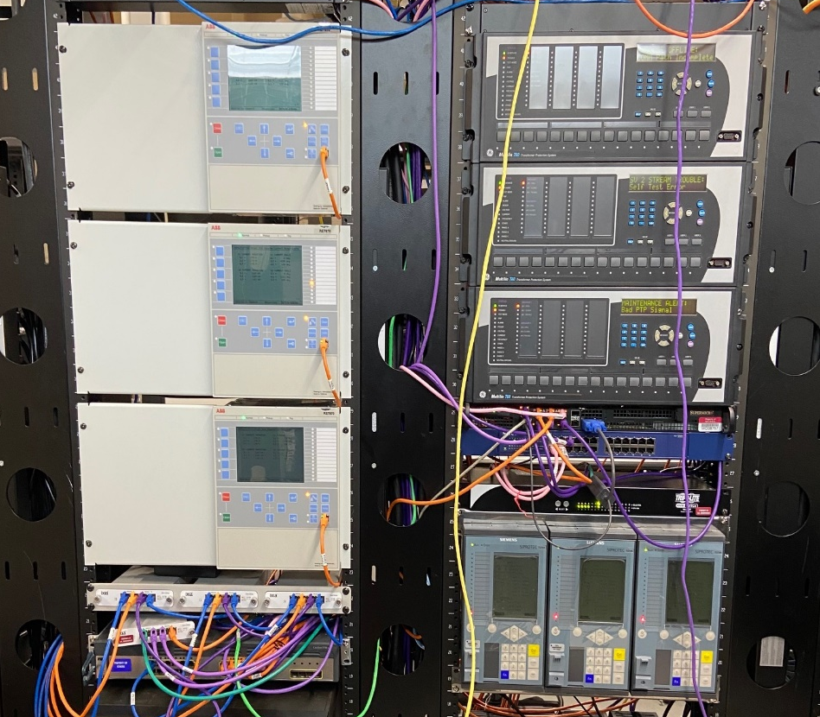
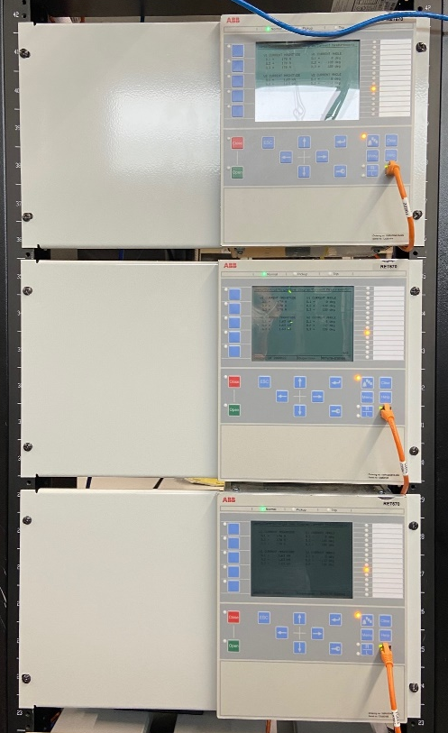
Spire for the Substation
The first real-time Byzantine-resilient architecture and protocols for the substation that simultaneously address system compromises and network attacks while meeting the strict timeliness requirement (4.167ms)
Hitachi
Energy
GE
Bommareddy, Sahiti, Daniel Qian, Christopher Bonebrake, Paul Skare, and Yair Amir.
“Real-time byzantine resilience for power grid substations.”
In 2022 41st International Symposium on Reliable Distributed Systems (SRDS), pp. 213-224. IEEE, 2022.
Sahiti Bommareddy, Maher Khan, David J Sebastian Cardenas, Carl Miller, Christopher Bonebrake, Yair Amir and Amy Babay.
“Real-Time Byzantine Resilient Power Grid Infrastructure: Evaluation and Trade-offs”.
In International Workshop on Explainability of Real-time Systems and their Analysis at the IEEE Real-Time Systems Symposium (RTSS 2022).
Siemens

Slide 11

Toward a Byzantine-resilient Architecture
Protective Relay
Protective Relay
Protective Relay
Malicious Relay
f=1
f+1 relays need to agree on an action
f+1=2

Slide 12
Toward a Byzantine-resilient Architecture
Protective Relay
Protective Relay
Protective Relay
Protective Relay
Malicious Relay
f=1
f+1 relays need to agree on an action
f+1=2
Relay for proactive recovery
k=1

Slide 13

Typical IEC61850 Substation Architecture
Measured
Data
(Sampled Values)
Protective Relay
Circuit Breaker
IED
Protective Relay

Slide 14
Byzantine-resilient Substation Architecture
Protective Relay
Relay
Proxy
Trip
Master
Measured
Data
(Sampled Values)
Protective Relay
Relay
Proxy
Trip
Master
Breaker
Proxy
Circuit Breaker
IED
Protective Relay
Relay
Proxy
Trip
Master
Protective Relay
Relay
Proxy
Trip
Master

Slide 15
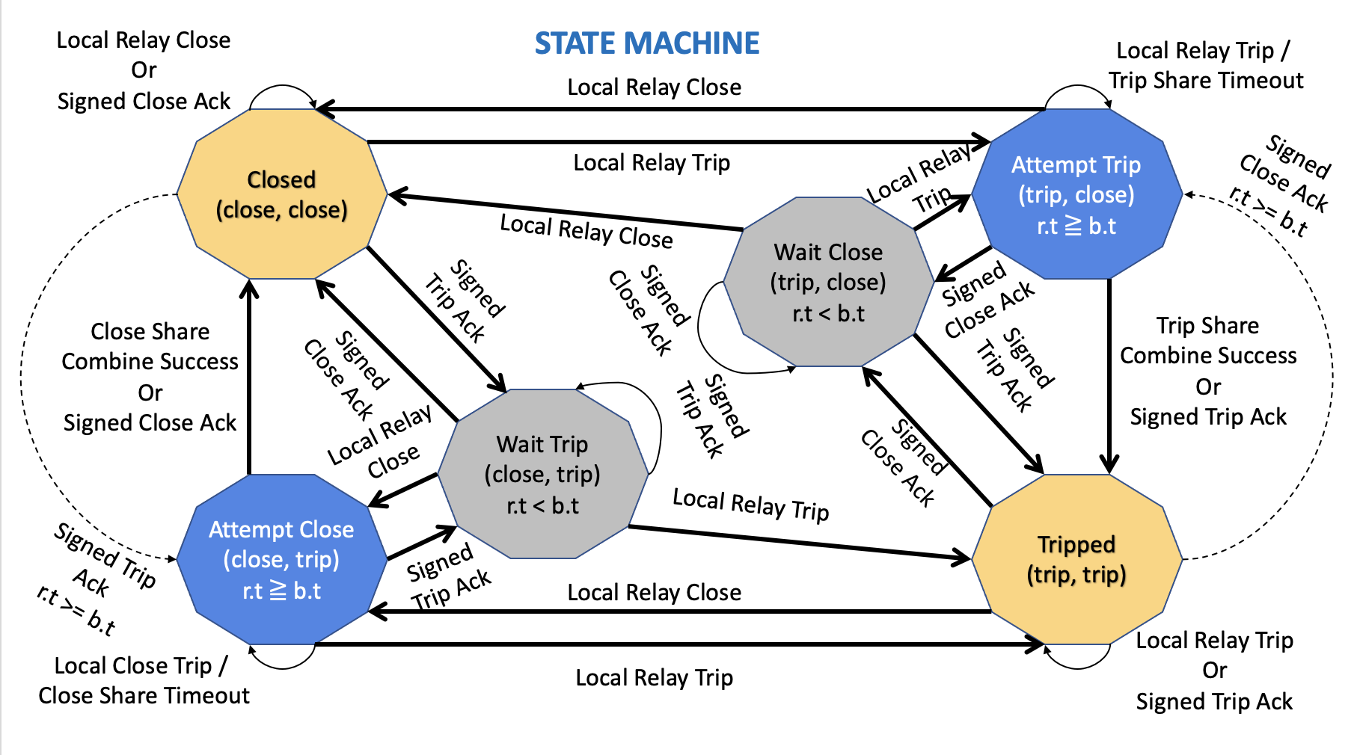
Protocol: State Machine

Slide 16
Evaluation Operating Conditions
Operation Condition | Explanation
Fault-Free (Normal) | All four relay nodes are working correctly
Fail-Stop Fault or Proactive Recovery | One of the relay nodes is unavailable due to a fail-stop fault or proactive recovery
Fail-Stop Fault and Proactive Recovery | One of the relay nodes is unavailable due to a fail-stop fault while simultaneously, an additional relay node is undergoing proactive recovery
Byzantine Fault | One of the relay nodes is under the control of a sophisticated attacker. Such compromised node performs two simultaneous attacks for each action : send corrupt share and short intermittent denial of service attacks
Byzantine Fault and Proactive Recovery | One of the relay nodes exhibits the Byzantine Fault condition described above, and simultaneously, an additional relay node is undergoing proactive recovery

Slide 17
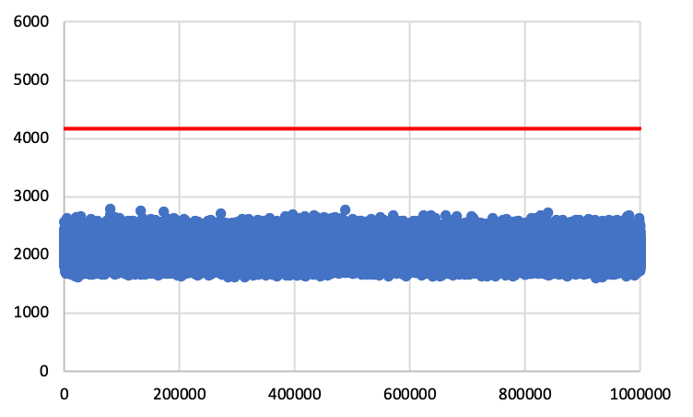
Performance Evaluation : Fault-free Operating Condition
Minimum / Average / Maximum
1604 / 2048 / 2789 microseconds
Latency in microseconds
Million Actions

Slide 18
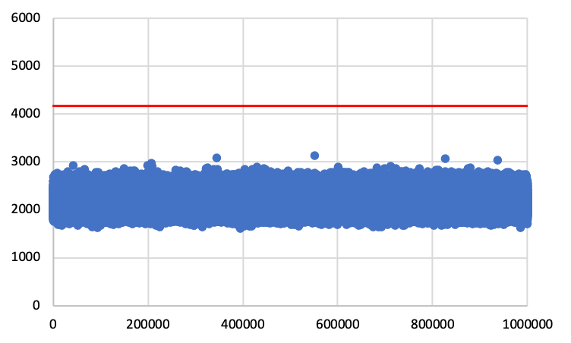
Performance Evaluation : Fail-Stop Fault or Proactive Recovery Operating Condition
Minimum / Average / Maximum
1604 / 2132 / 3135 microseconds
Latency in microseconds
Million Actions

Slide 19
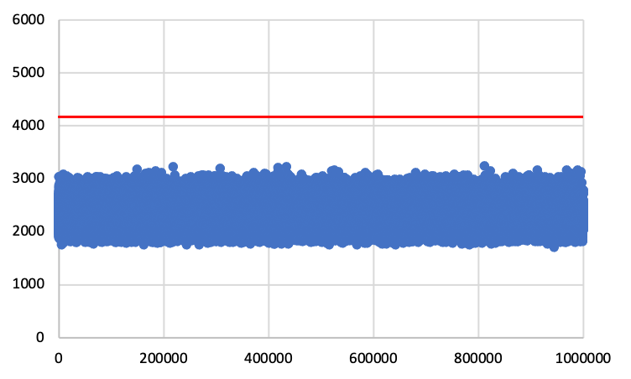
Performance Evaluation : Byzantine Fault Operating Condition
Minimum / Average / Maximum
1716 / 2268 / 3253 microseconds
Latency in microseconds
Million Actions

Slide 20
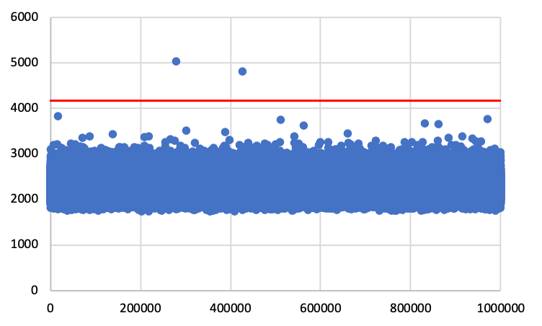
Performance Evaluation : Byzantine Fault and Proactive Recovery Operating Condition
Minimum / Average / Maximum
1733 / 2261 / 5028 microseconds
Latency in microseconds
Million Actions

Slide 21
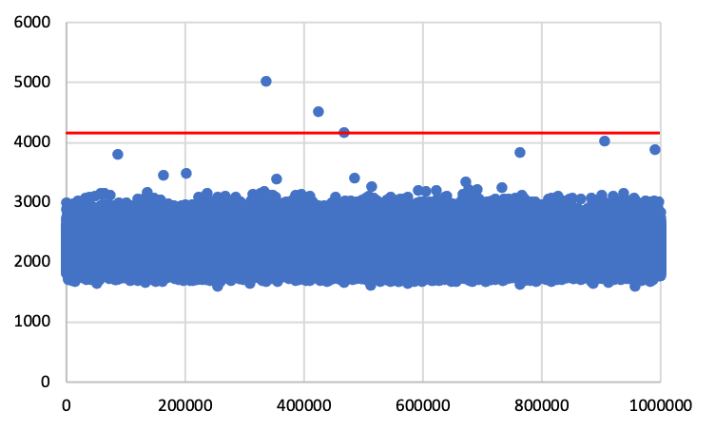
Performance Evaluation : Fail-Stop Fault and Proactive Recovery Operating Condition
Minimum / Average / Maximum
1595 / 2167 / 5025 microseconds
Latency in microseconds
Million Actions

Slide 22
Real-Time Kernel Option
With only two nodes available, a random delay on either node (e.g., from network delays, kernel scheduling, or even effects of a Byzantine node’s actions) would be reflected in the end-to-end latency
Real-time kernel is optimized to maintain low-latency consistent response time and determinism
The determinism and latency stability of real-time kernel help to always meet the real-time requirement in all operating conditions
Sahiti Bommareddy, Maher Khan, David J Sebastian Cardenas, Carl Miller, Christopher Bonebrake, Yair Amir and Amy Babay.
“Real-Time Byzantine Resilient Power Grid Infrastructure: Evaluation and Trade-offs”.
In International Workshop on Explainability of Real-time Systems and their Analysis at the IEEE Real-Time Systems Symposium (RTSS 2022).

Slide 23
Machine Learning-based Situational Awareness
We use machine learning-based intrusion detection
Unsupervised Models
Bag of Models
Out-of-Band Detection
Two levels of Modules: Network-level and Power system-level
Network level Module
Packet Analysis-based Models
Traffic Flow-based Models
Power systems level module

Slide 24
Spire for the Substation
The first real-time Byzantine resilient architecture and protocols for the substation that simultaneously address system compromises and network attacks while meeting the strict timeliness requirement (4.167ms)
Successful red team experiment in 2022 (Sandia National Laboratories @ PNNL)
Industry Transition (GE 12/2022, Siemens 1/2023, perhaps Hitachi Energy)
Johns Hopkins open-source release: Spire 2.0 (www.dsn.jhu.edu/spire)
Bommareddy, Sahiti, Daniel Qian, Christopher Bonebrake, Paul Skare, and Yair Amir.
“Real-time byzantine resilience for power grid substations.”
In 2022 41st International Symposium on Reliable Distributed Systems (SRDS), pp. 213-224. IEEE, 2022.
Sahiti Bommareddy, Maher Khan, David J Sebastian Cardenas, Carl Miller, Christopher Bonebrake, Yair Amir and Amy Babay.
“Real-Time Byzantine Resilient Power Grid Infrastructure: Evaluation and Trade-offs”.
In International Workshop on Explainability of Real-time Systems and their Analysis at the IEEE Real-Time Systems Symposium (RTSS 2022).

Slide 25
Questions / Comments
www.dsn.jhu.edu/spire
yairamir@jhu.edu

Slide 26
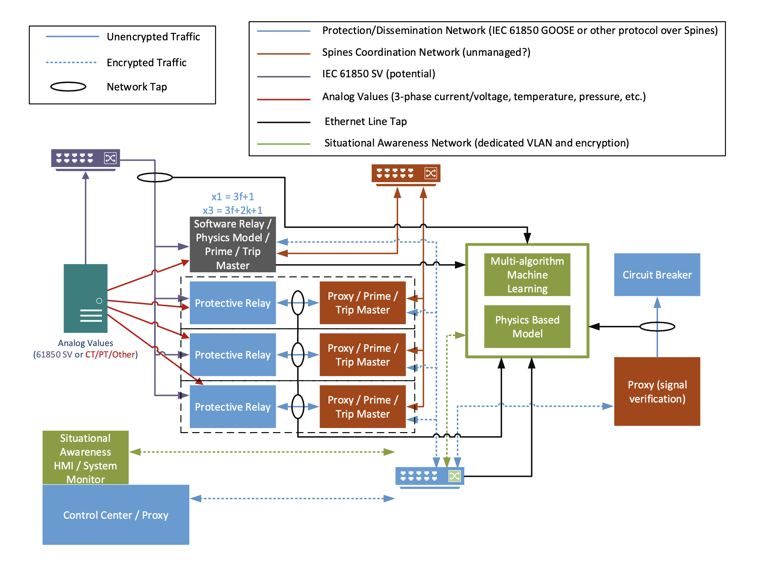
Backup Slide 1
Substation

Slide 27
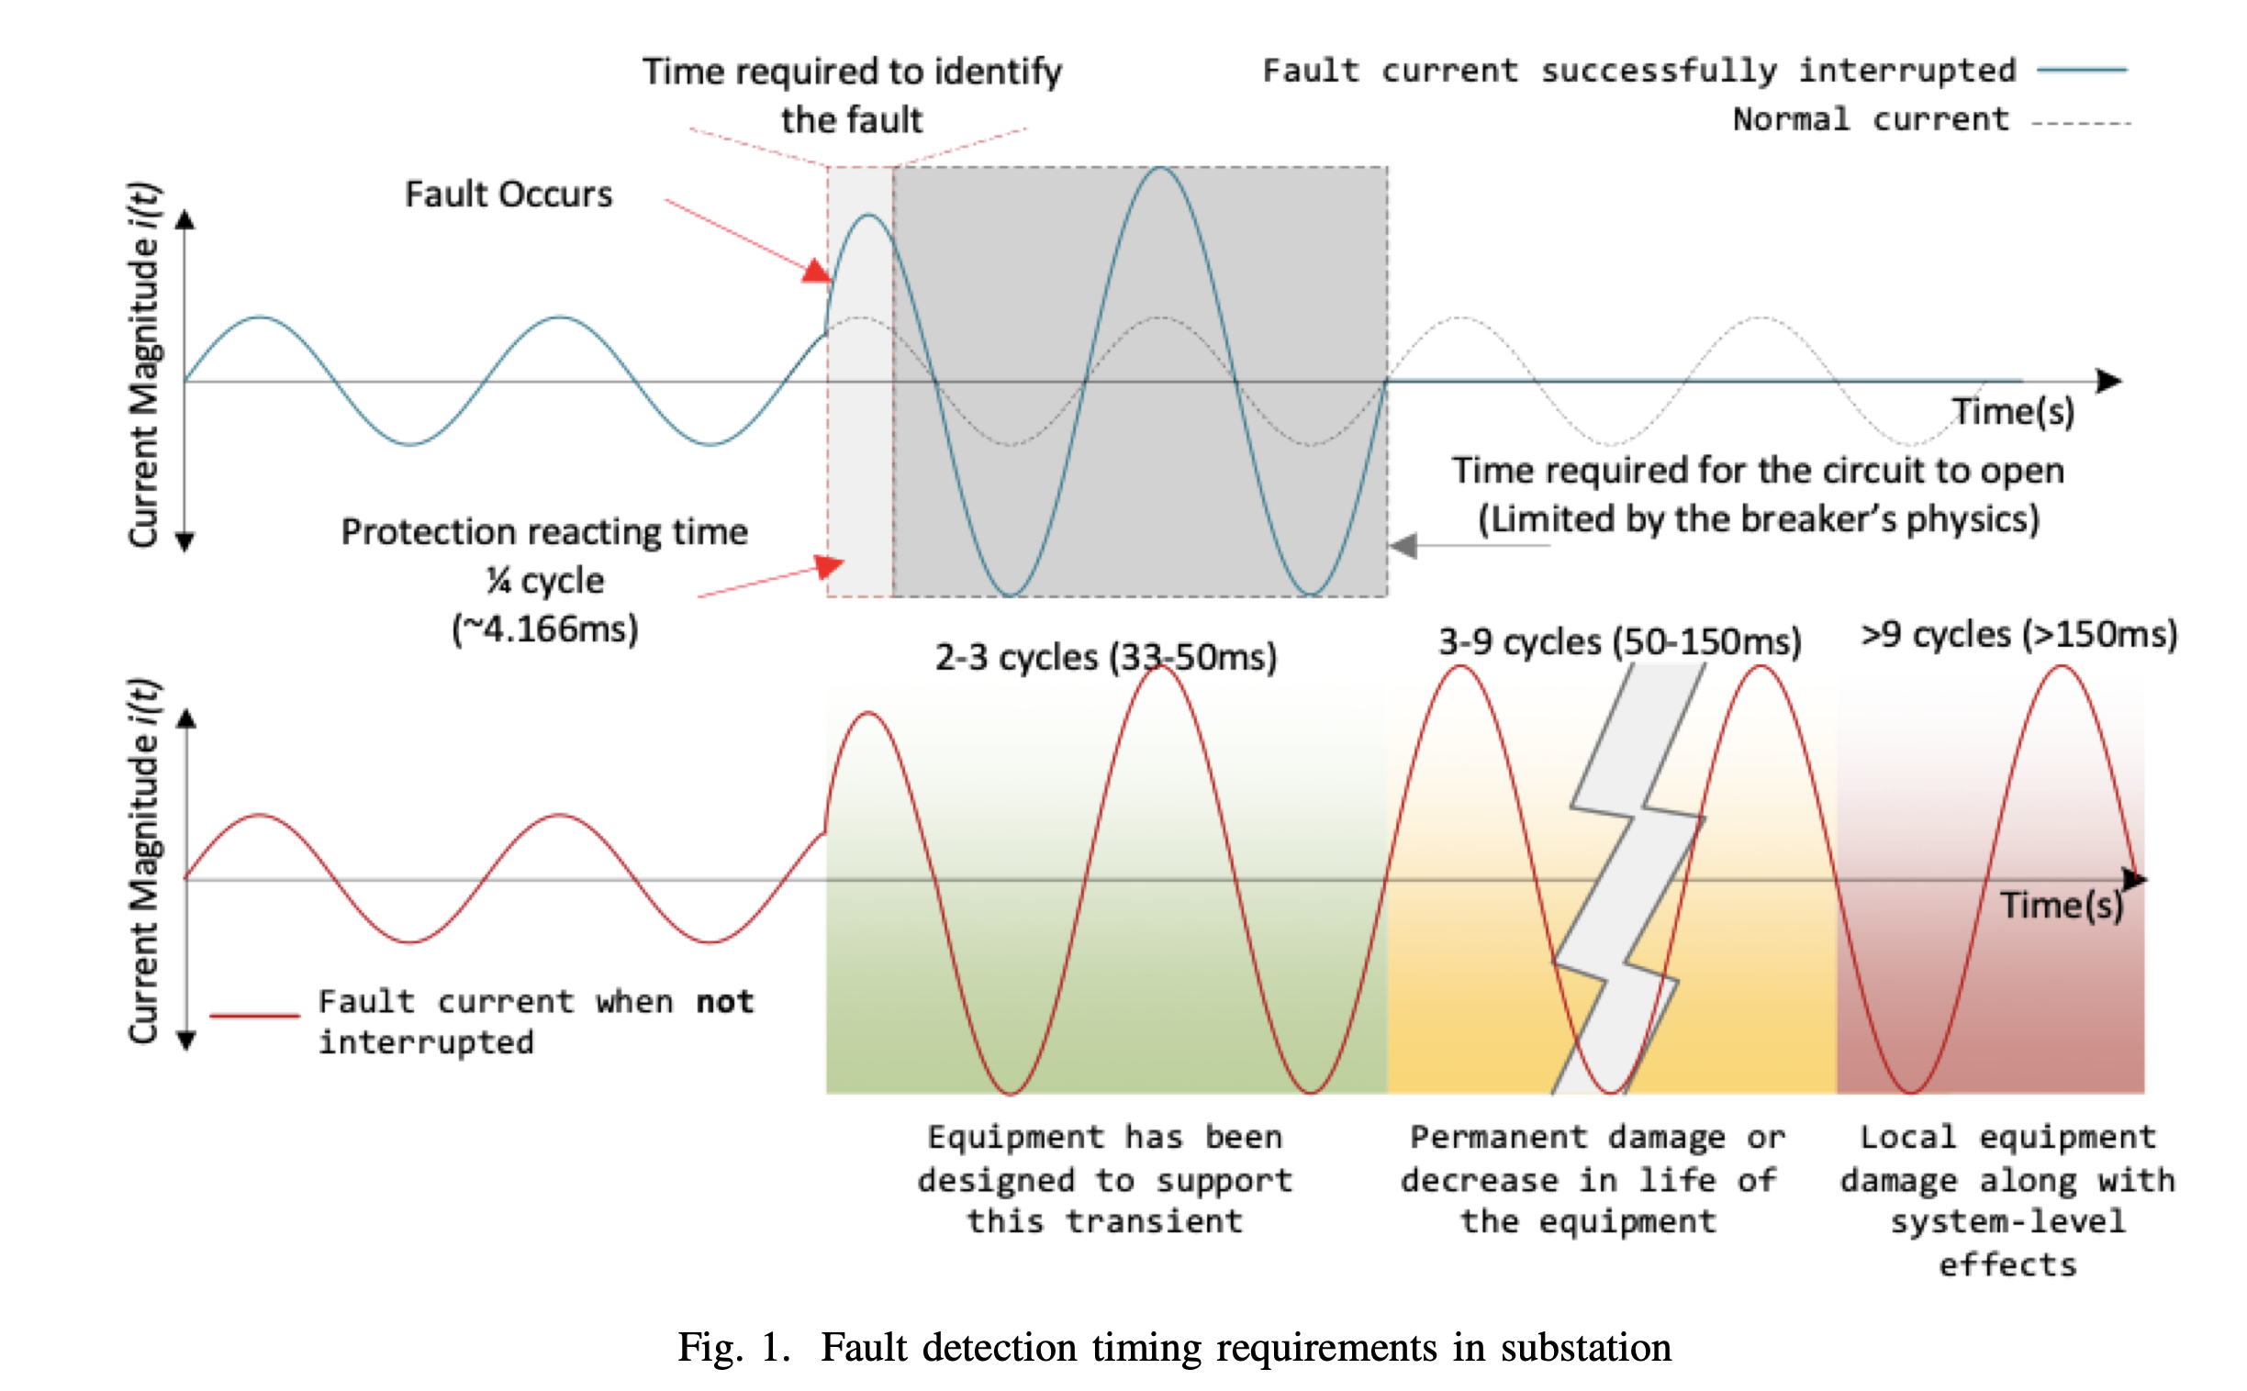
Backup Slide 2

Slide 28
STATE MACHINE
state=(relay, breaker)
Local Relay Close
Or
Signed Close Ack
Local Relay Trip /
Trip Share Timeout
Local Relay Close
Closed
(close, close)
Attempt Trip
(trip, close)
r.t ≧ b.t
Local Relay Trip
Signed Close Ack
r.t >= b.t
Local Relay
Trip
Local Relay Close
Wait Close
(trip, close)
r.t < b.t
Signed
Trip Ack
Signed
Close Ack
Signed
Close Ack
Close Share
Combine Success
Or
Signed Close Ack
Trip Share
Combine Success
Or
Signed Trip Ack
Signed
Close Ack
Signed
Trip Ack
Wait Trip
(close, trip)
r.t < b.t
Signed
Trip Ack
Local Relay
Close
Signed
Close Ack
Attempt Close
(close, trip)
r.t ≧ b.t
Local Relay Trip
Tripped
(trip, trip)
Signed
Trip Ack
Local Relay Close
Local Relay Trip
Or
Signed Trip Ack
Local Close Trip /
Close Share Timeout
Local Relay Trip
28

